Slide 1
From Burnout to Balance
Practical Strategies for Stress Relief in the Classroom
ŽSV učitelja Engleskog jezika Međimurske županije, Hodošan, 17.3.2026
Jura Cmrečak

Slide 2
Why This Particular Course?
Who is usually in the focus if there is a course/seminar/lecture on mental health?
The focus is usually on managing and relieving stress and being aware of wellbeing, emotions and behavious of the______________?

Slide 3
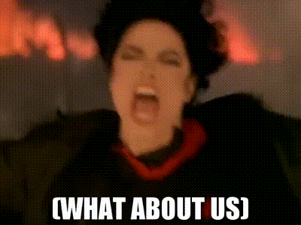

Slide 4
The Great Expectations I
We have to be experts on our subjects (which is a great starting point); however, we also have to: be therapists, entertainers, magicians, detectives, nurses, doctors and wish granters.
Our lessons have to engaging and fun for 20+ different personalities
Grade and check schoolwork, homework and exams often and simultaneously be the laziest profession (achieving work-life balance can be challenging)

Slide 5
The Great Expectations II
Be fun, fair, honest, but if we do exactly that we can expect emails and calls from parents
Parents expect us to ”fix ” their children, especially their motivation
Notice everything going on in the classroom, as well as notice changes in our students’ behaviour (if this seems easy, remember, you also need to teach)

Slide 6
The Great Expectations III
We ought to never lose our patience, even when we are asked the same question for the 111th time
Keep perfect records of everything, even though I doubt people actually read half of the reports we write (school admin, parents, child’s development)
Be available to help from entering to leaving the building and also on the parking lot

Slide 7
The Great Expectations IV
Immediately answer emails
Maintain the classroom and peace and order in the classroom
You need to adjust to every position you are put in
Now take everything I have mentioned, add your own grievances and issues and do everything on the list simultaneously

Slide 8
Are these expectations a bit much?
Obviously yes.

Slide 9
Can they cause burnout?
Also yes.

Slide 10
Have you ever experienced burnout?
This part is a bit interactive, sorry.
We haven’t clinically defined burnout yet; however, that doesn’t mean you don’t understand your inner works.
If you have ever felt defeated, over and done, resignated, desperate, overworked and/or empty due to your work, please raise your hand
If I guessed correctly, more than 2 people should have their hands up

Slide 11
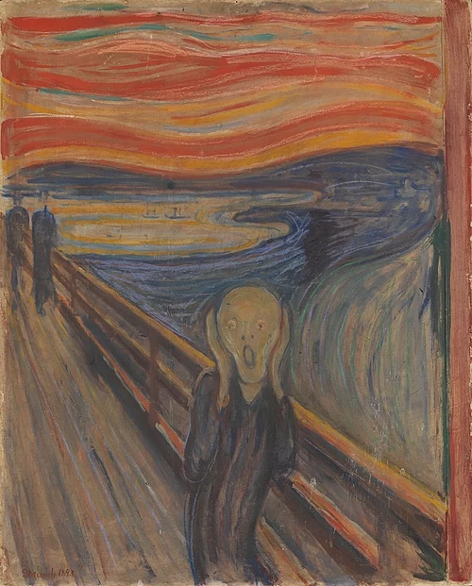
So, how get from this point…

Slide 12
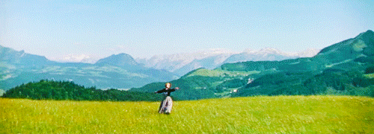
…to this one?

Slide 13
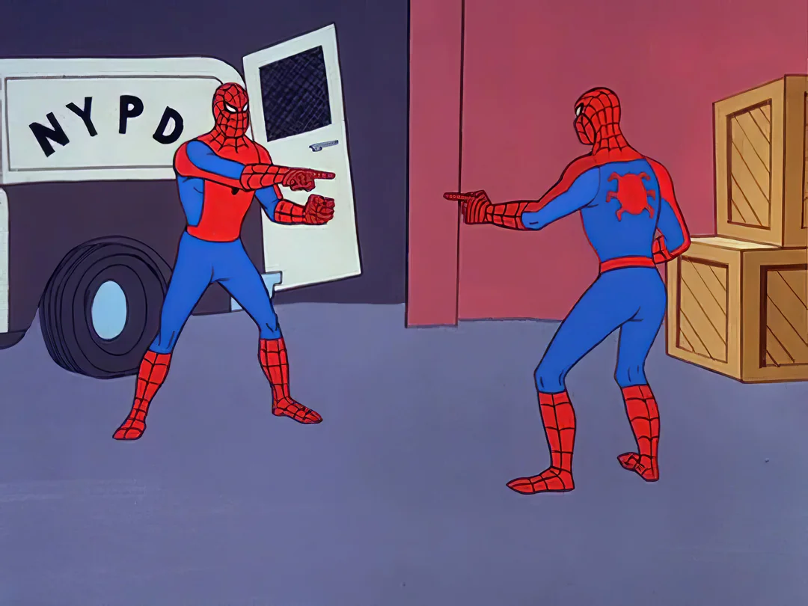
The only person that can actually help you is…

Slide 14
It will be incredibly difficult to do justice to this course. It lasted for 6 days and we have done numerous exercises in which we had to get in touch with ourselves.
After we agreed that we are as burnt as coal, we decided to see how it affects our bodies and by extention, mood.
In order to get something from this lecture, I ask you to keep an open mind. You won’t have to do anything today, but the things I will propose will be made available for you so you can do everything in the privacy of your home.

Slide 15
Additionally, I will provide you with materials that are connected to psychology (mostly theoretical) and wellbeing (mostly practical).
If something like this seems interesting to you, you can actually take this course in Valencia next month and in May.

Slide 16
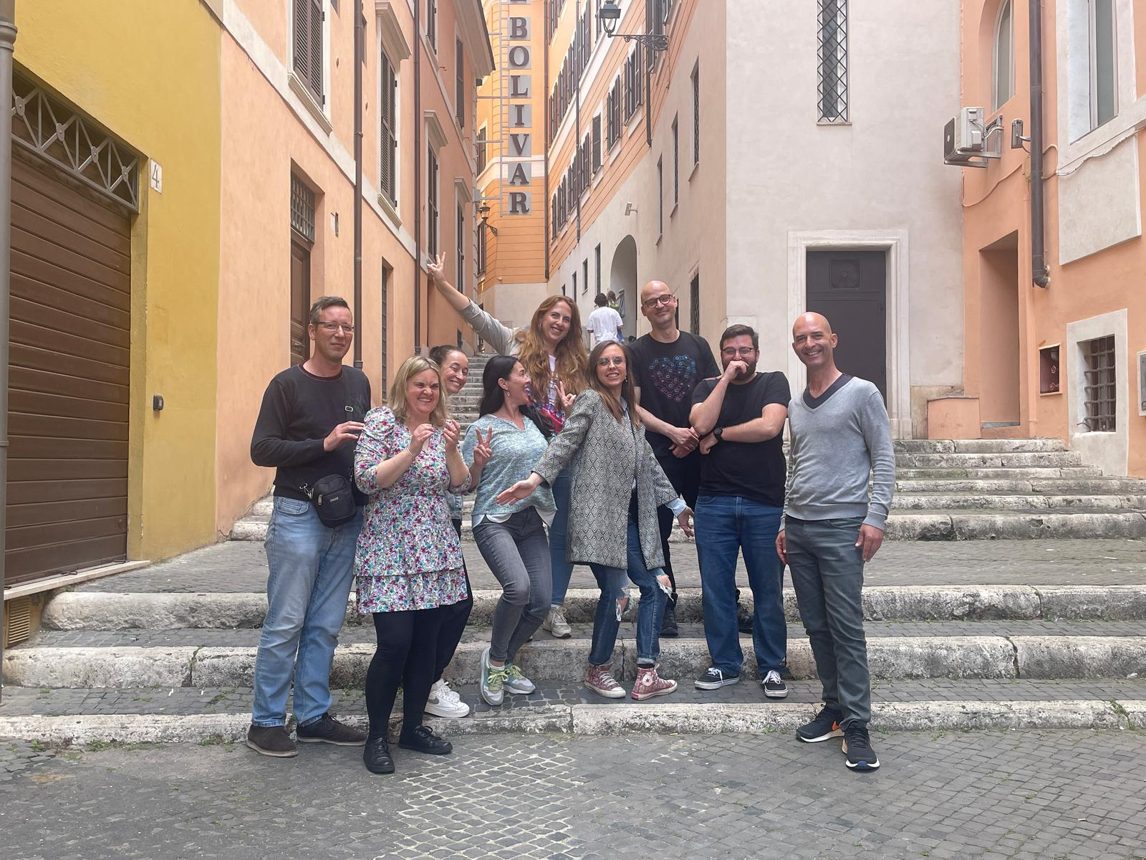

Slide 17
Gestalt Approach
To be honest, I copied this from Dr. Alina’s webpage
An approach aimed at focusing on the experience of the present moment and the context of your life
It’s goal is to increase self-awareness and self-acceptance, allowing you to address unresolved issues and emotional pain
It is based on the principle that the individual is an integrated unity of mind and body, and on the importance of recognizing one’s needs and experiences at the present moment.

Slide 18
Present Moment (Not Tense, Not Simple)
It is rather tricky to determine your current state. It cannot be done immediately, people usually need some time for introspection.
Do you feel any discomfort in any of your body parts? Do you find it difficult to breathe? Do you feel pressure in your chest? Pain in certain part of your head? Depressed? Anxious? Empty? These are actually symptoms of chronic burnout.
You can’t tell immediately? Close your eyes, clear your mind and breathe deeply. Imagine your body as those 8th grade biology sketches of a human body and see if anything flares up and/or burns red.

Slide 19
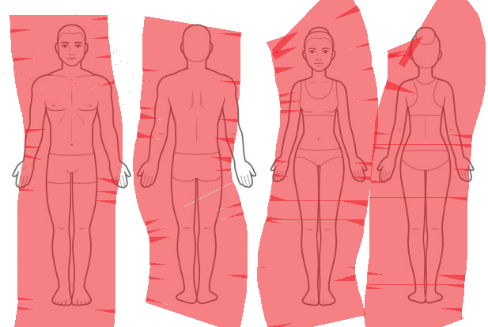
If this is you, I’ll hurry up

Slide 20
Put up the drawing here

Slide 21
Additional Materials
How to spot distress in our students
Scientific approach to stress
How to incorporate mindfulness in our work
Etc.
I highly suggest you go over the presentation because it is packed with useful information

Slide 22
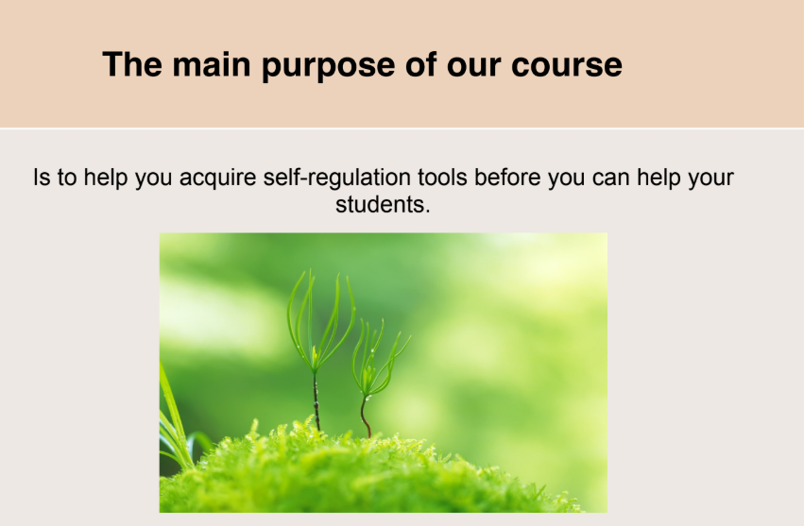
Course Highlights (With Focus on Ourselves and Methodology)

Slide 23
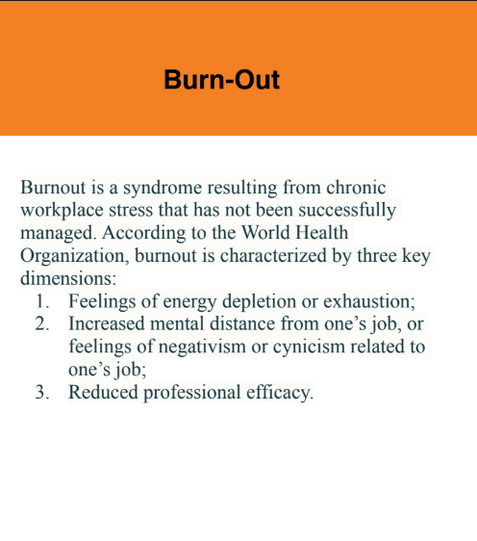
I didn’t make this, but it’s still good

Slide 24
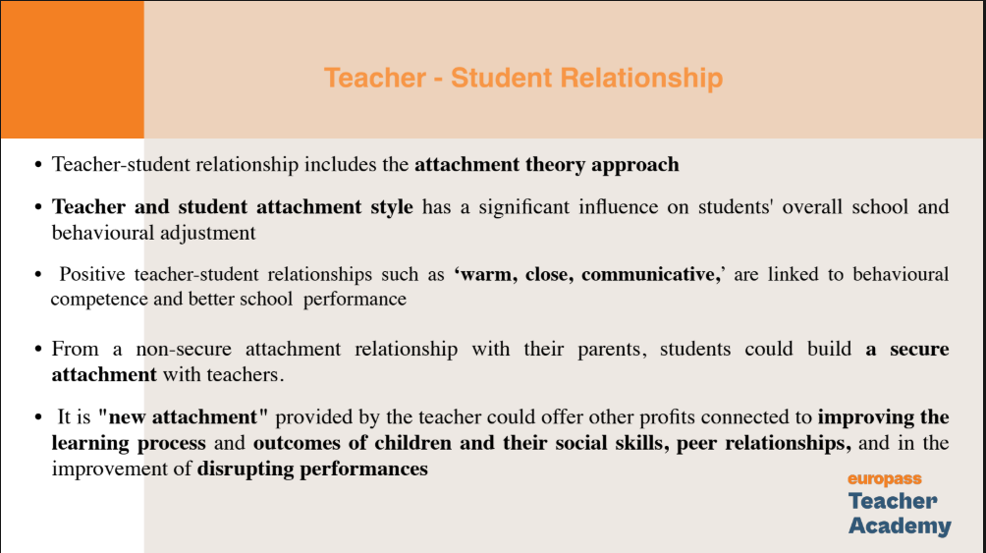
We Can Help by Helping Others

Slide 25
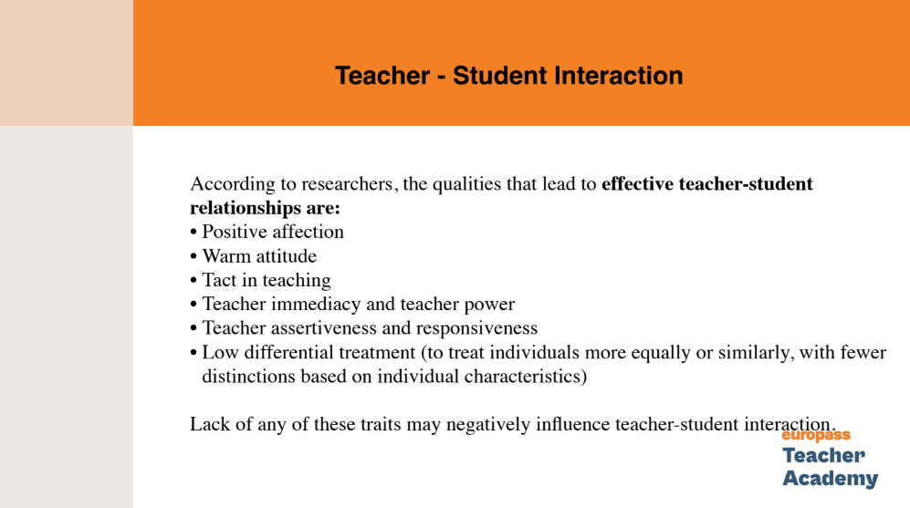

Slide 26
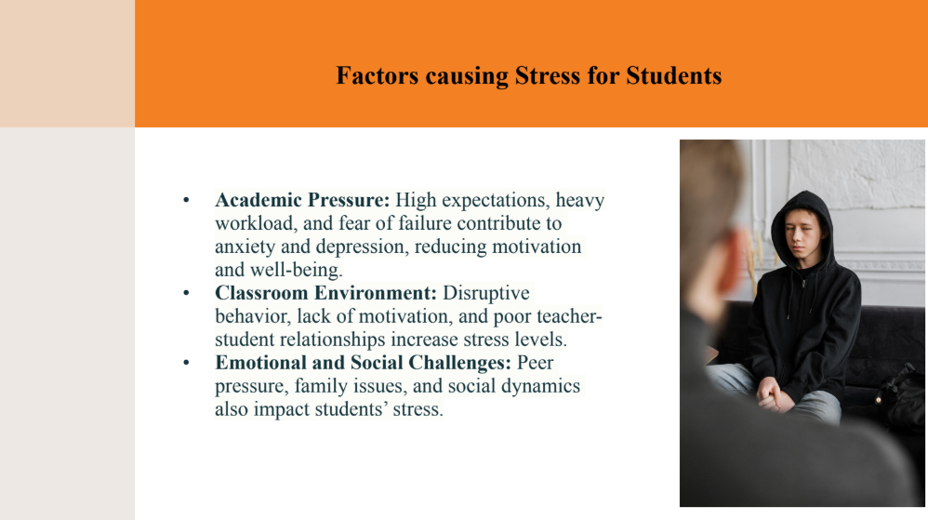

Slide 27
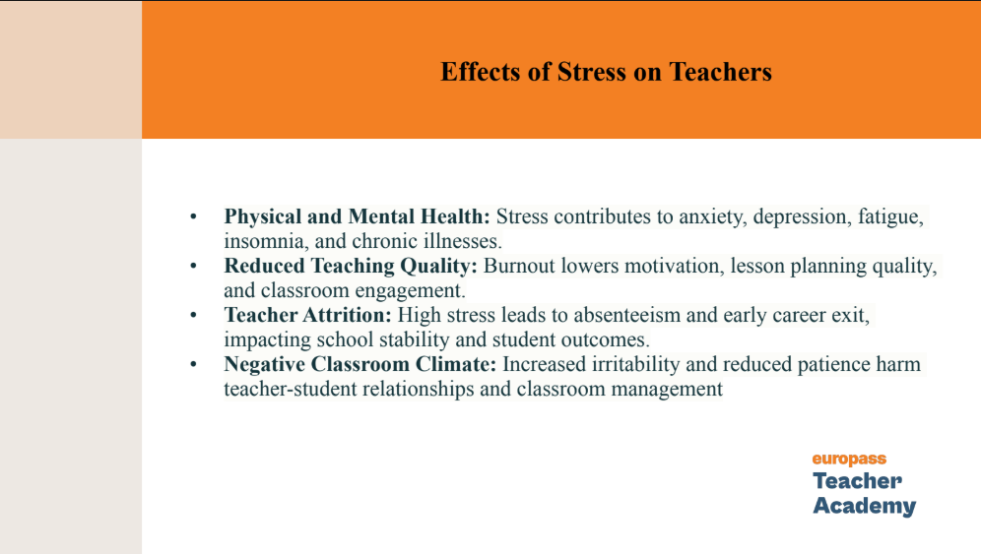

Slide 28
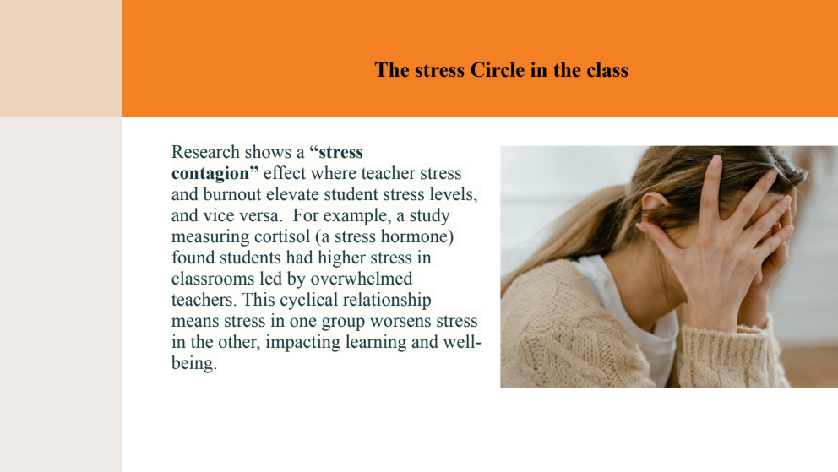

Slide 29
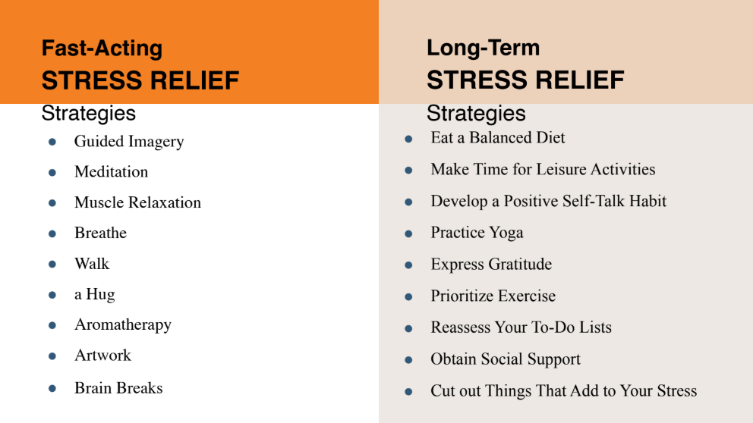

Slide 30
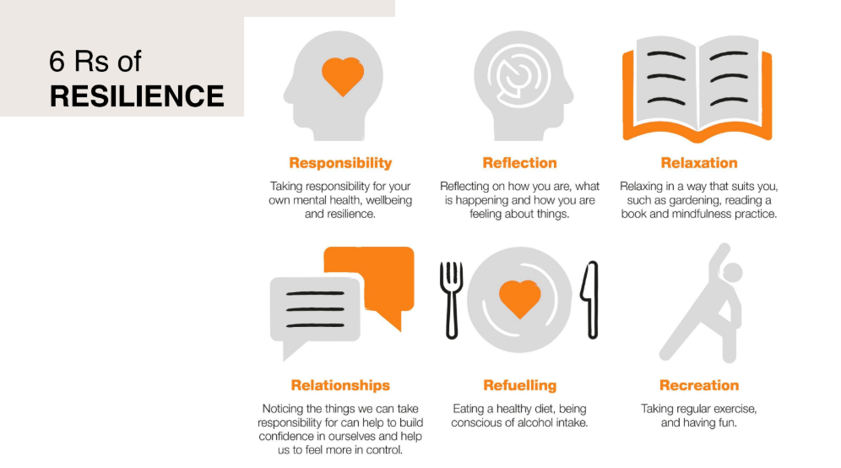

Slide 31
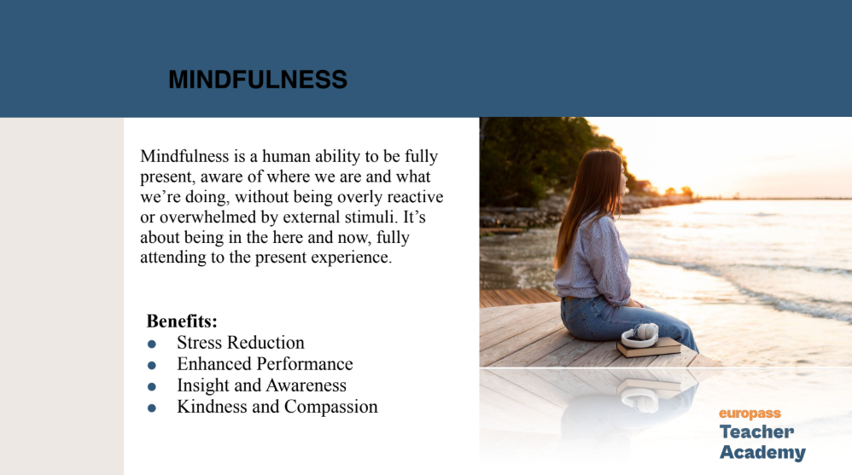

Slide 32
Mindfulness Exercises Include
Breathing
Visualisation
Movement
Is this something we can implement in our classrooms? Kind of. Maybe. Sometimes.

Slide 33
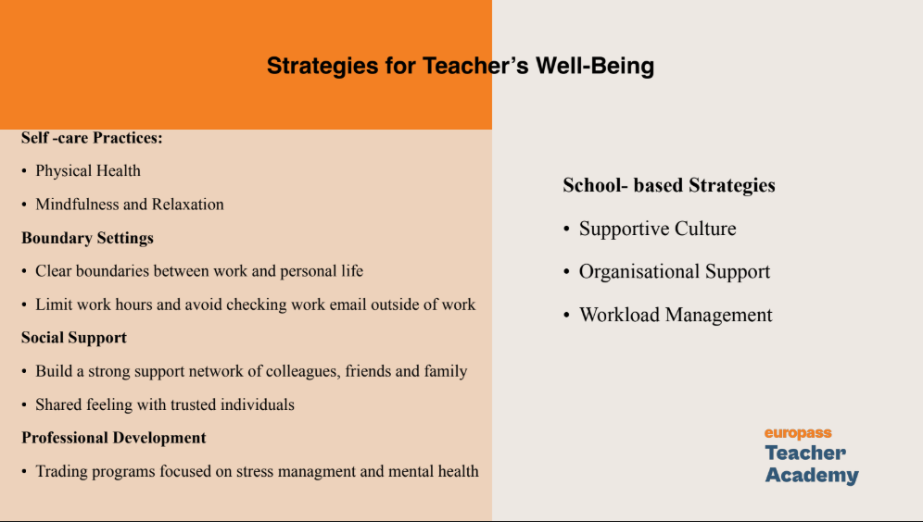

Slide 34
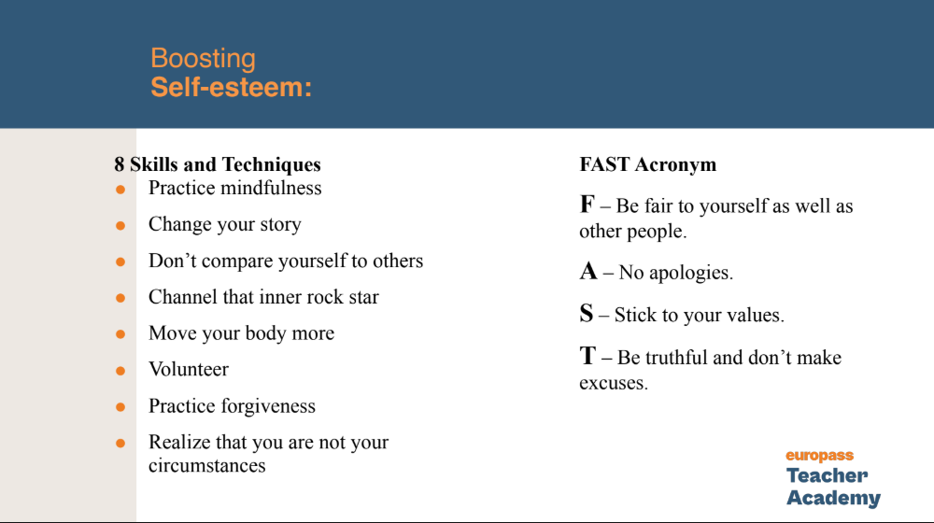

Slide 35
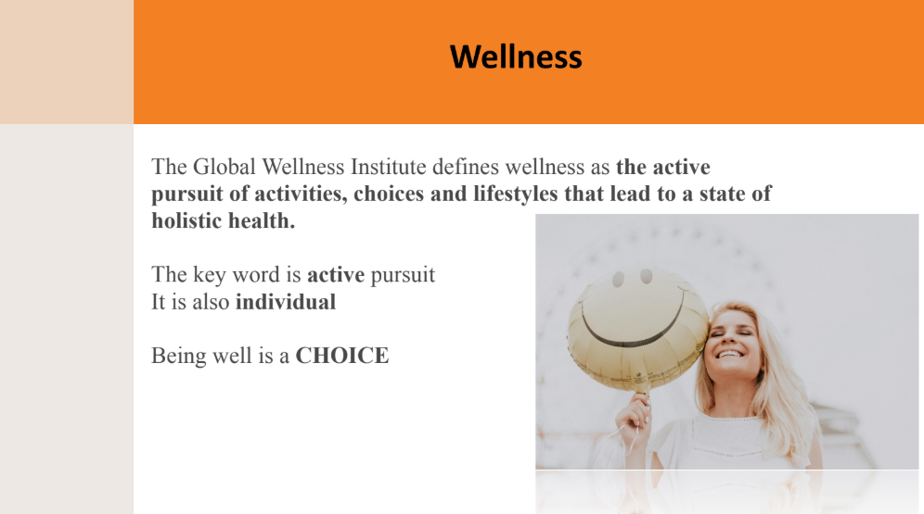

Slide 36
Final Thoughs
I covered a small percentage of the course and I hope that some things I said today will inspire you to take better care of yourself.
There is still much to say, discuss, do. We are not limitless, neither is our time.
On a personal note

Slide 37
Thank you for your attention
Any questions?

Slide 38
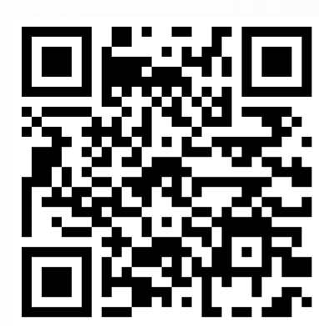
https://forms.gle/hPVfKrGesdjVnrrKA

Slide 39
https://drive.google.com/file/d/11c5a_apKBjItMq8HdDg_yiDnOfcMlvEk/view
https://greatergood.berkeley.edu/quizzes/take_quiz/stress_and_anxiety
30 Minute Yoga Nidra For Deep Rest

