Slide 1




Slide 2

Introduction
“Once you learn to _________, you will be forever free.” Frederick Douglass
“_________ are mirrors: you only see in them what you already have inside you.” Carlos Ruizz Zafón
“Today a _________, tomorrow a leader.” Margaret Fuller
“Think before you speak. _________ before you think.” Fran Lebowitz
“__________ is to the mind what exercise is to the body.” Joseph Addison
“The ________ of all good books is like conversation with the finest (people) of the past centuries.”Descartes
“The whole world opened up to me when I learned to _________” Mary Mcleod Bethune
“_________ are a uniquely portable magic.” Stephen King
In small groups or pairs, read the following sayings and try to guess the missing words:

Slide 3
Introduction
In small groups or pairs, read the following sayings and try to guess the missing words:
“Once you learn to read, you will be forever free.” Frederick Douglass
“Books are mirrors: you only see in them what you already have inside you.” Carlos Ruizz Zafón
“Today a reader, tomorrow a leader.” Margaret Fuller
“Think before you speak. Read before you think.” Fran Lebowitz
“Reading is to the mind what exercise is to the body.” Joseph Addison
“The reading of all good books is like conversation with the finest (people) of the past centuries.” Descartes
“The whole world opened up to me when I learned to read.” Mary Mcleod Bethune
“Books are a uniquely portable magic.” Stephen King

Slide 4
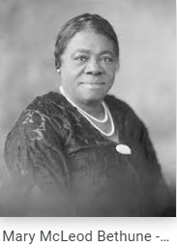
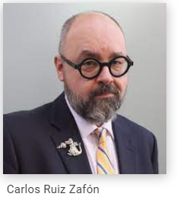
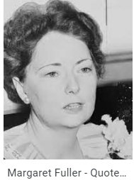
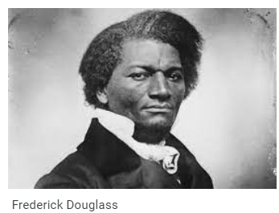
Introduction
Have you ever heard of any of the authors?
What do you know about them?
Do an online research:
choose an author
find a few pieces of information about him/her
share it with the rest of the class
Notes:
Photos credit: https://www.nps.gov/mamc/learn/historyculture/mary-mcleod-bethune.htm
https://fraktura.hr/autori/carlos-ruiz-zafon
https://www.biography.com/writer/margaret-fuller
https://kids.nationalgeographic.com/history/article/frederick-douglass
4

Slide 5
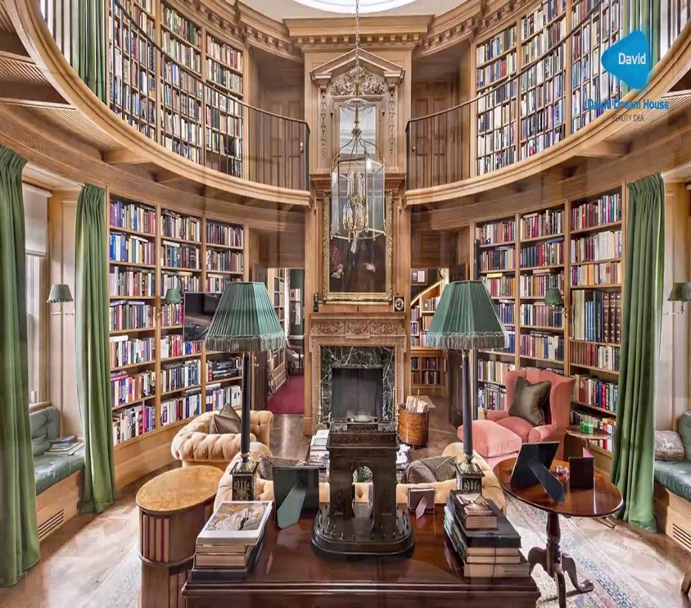
Introduction
Look at the photo and, in small groups or pairs, discuss the following questions:
What can you see in the photo?
Would you like to spend your time in this library? Why yes/no?
Imagine you could find any book that you can think of in this marvelous room. Which one would you choose to read and why?
What kinds of book interest you most? Fantasy, Sci-Fi, Mystery, Romance, Drama(...)?
Do you prefer reading paper books or e-books? Why?
Have you ever read a book in English or any other foreign language? If yes, which one?
Notes:
Photo credit: https://www.ledevoir.com/economie/466197/conrad-black-a-vendu-sa-maison-pour-16-5-millions
5

Slide 6
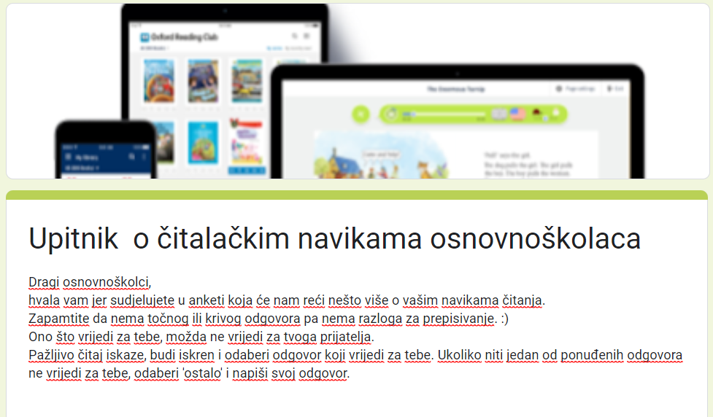
Reading Survey
Think about your reading habits and answer the questions in the Reading Survey.
Read the statements carefully and choose the answer that you consider to be true for you.
If there is no answer that fits you, write your own answer.
Be honest and remember that there is no right or wrong answers.

Slide 7

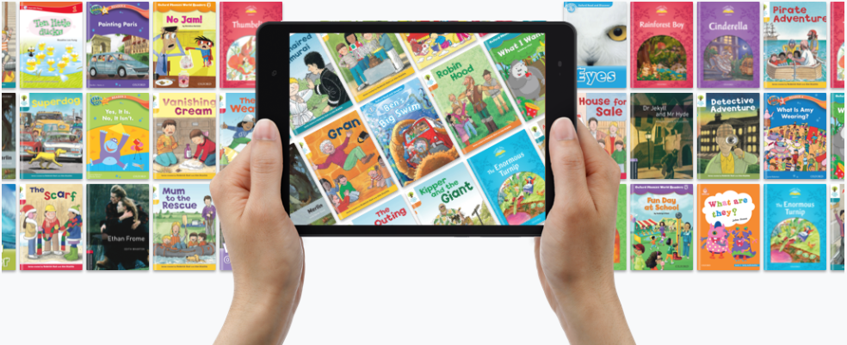
Read your way to better English
This school year you will be a member of a book reading club named Read your way to better English! ☺
In your opinion, how does a book club function? Have you ever been a part of any?
What do you expect to read or do?
Have you ever used a digital library? Which one? How does it work?
In pairs or small groups think of reading and finish the sentence:
I have never (been a part of a reading club, read a book in English, used a digital library, written a book report....)
Notes:
Photo credit: https://www.facultyfocus.com/articles/course-design-ideas/new-evidence-on-cooperative-learning/
7

Slide 8
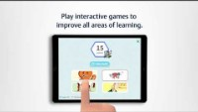
About our new, digital library in less than a minute!
You will be reading amazing e-books in an online library called Oxford Reading Club.
Watch the short video about Oxford Reading Club and write down at least 2 characteristics that you find interesting, useful, practical (...)
You can pause the video as many times as you want to make notes or comments. ☺
Notes:
Video credit: Oxford Reading Club – YouTube

Slide 9
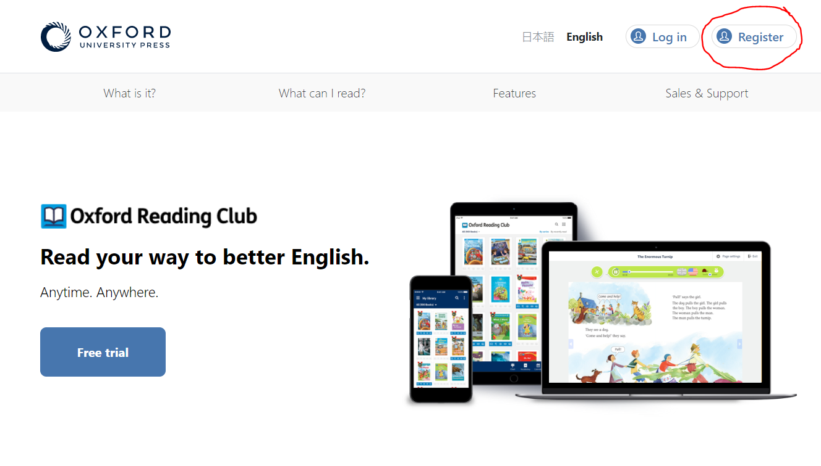
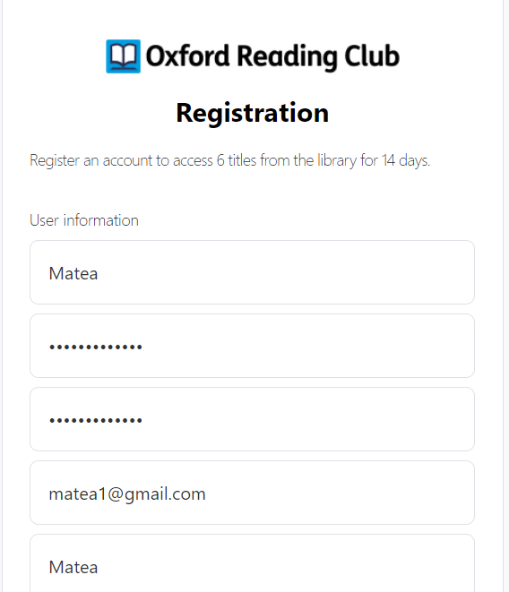
Let’s register first!
Before starting your reading journey, follow these 5 steps to register:
Step 1: Go to www.oxfordreadingclub.com and click on Register.
Step 2: Fill in the information needed to register:
Choose a username
Create a password (minimum 6 characters long)
Confirm your password
Enter your email address.
Enter your name
Enter your surname
Enter your country (Croatia)
Under Institution, enter the name of the school.
Select from student or teacher

Slide 10
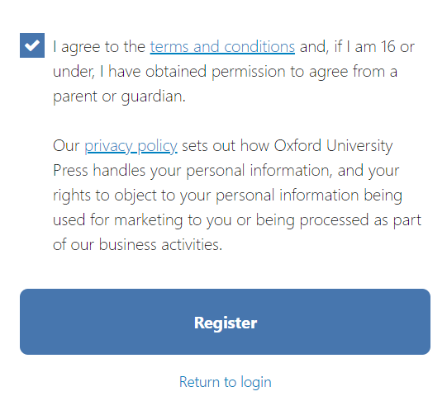

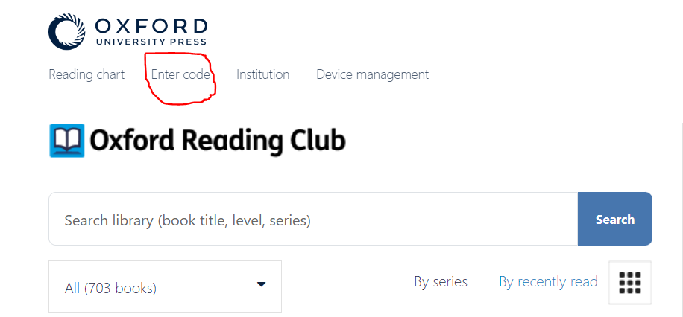
Let’s register first!
Step 3: Read the terms and conditions and tick that you have read and agree to them. Then click on the blue Register button.
Your registration is then complete, and you can log in by clicking the Log in button.
Step 4: Click Enter Code after logging in.
Step 5: Enter the 12-digit access code and confirm with the blue Enter code button.
Congratulations! Your code is activated, and you can start using Oxford Reading Club.
Notes:
https://www.google.com/url?sa=i&url=https%3A%2F%2Fstock.adobe.com%2Fsearch%3Fk%3Dcongratulations&psig=AOvVaw14I4otcjA9VWh3RQZU-gUN&ust=1664530589476000&source=images&cd=vfe&ved=0CAwQjRxqFwoTCNDx--XZufoCFQAAAAAdAAAAABAE
10

Slide 11

Exploring Oxford Reading Club
Different reading collections
Tracking progress (reports, badges)
You have 10 minutes to explore your new, digital library in pairs or small groups.
There are so many cool options you can find in the library that will help you with reading.☺
Before exploring, look at the hints around the rose. They might help you.
5 steps reading process
Different options: record, pen, dictionary(...)
American or British dialect
Graded books (more levels)
Where to start test
Read and/or listen
My profile

Slide 12
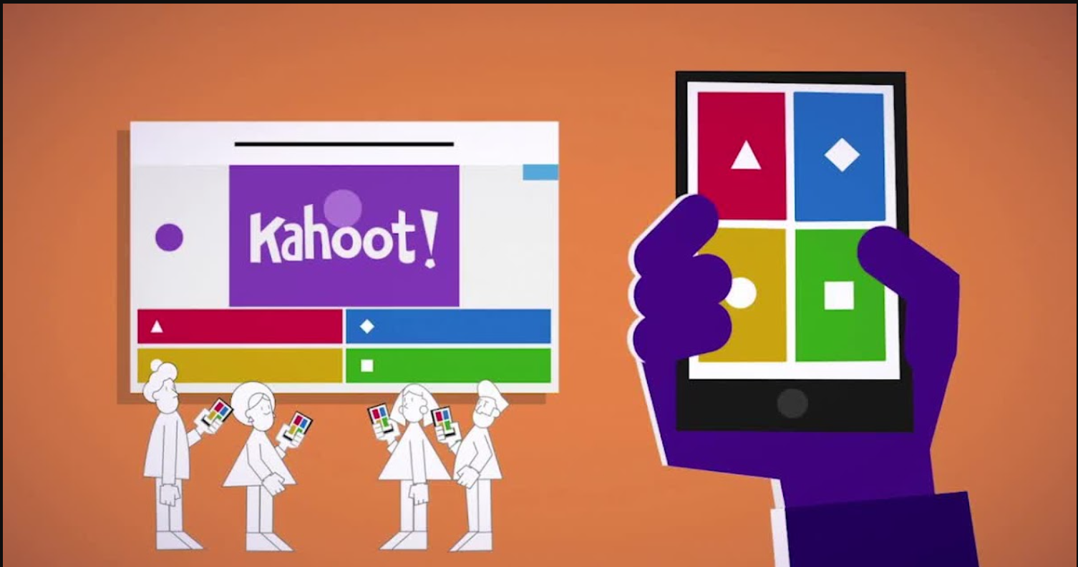
Quizz time!
Now, let’s see how much we already know about Oxford Reading Club.
Click here and play a short Kahoot quiz.
You can play in pairs, groups or individually.
Are you happy with the results? ☺
Any questions about your new, digital library?
Notes:
Photo credit:https://www.facebook.com/HundrEDorg/photos/kahoot-is-a-game-based-learning-platform-that-allows-educators-to-create-fun-lea/2565491950382534/
12

Slide 13



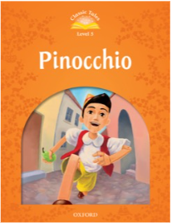
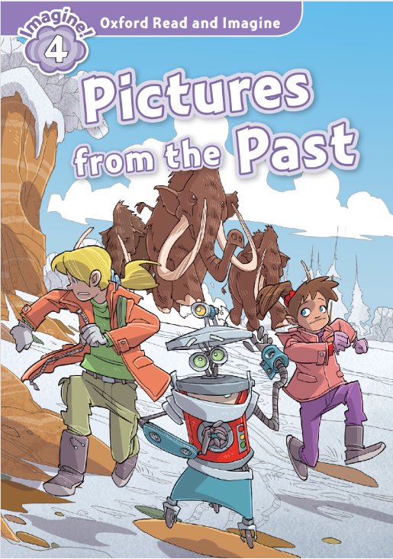
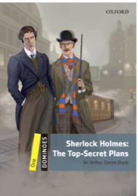

Where to start?
Quickly skim and scan through each reading collection and comment these question in pairs or small groups:
Which collection(s) look most interesting and why?
How many different book genres can you find in your online library Oxford Reading Club?
Watch a short video to remind yourself of the different book genres.
Pause the video as many times as neccesary to make notes.
3) How many levels are there in each collections?
4) What level should you start with? Why?
.
Notes:
Video credit: https://www.youtube.com/watch?v=0mFKgjAOUJ0&t=2s
13

Slide 14
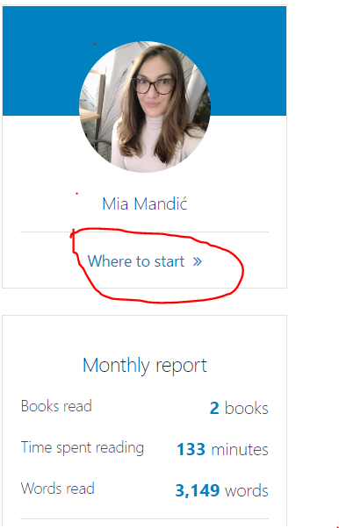
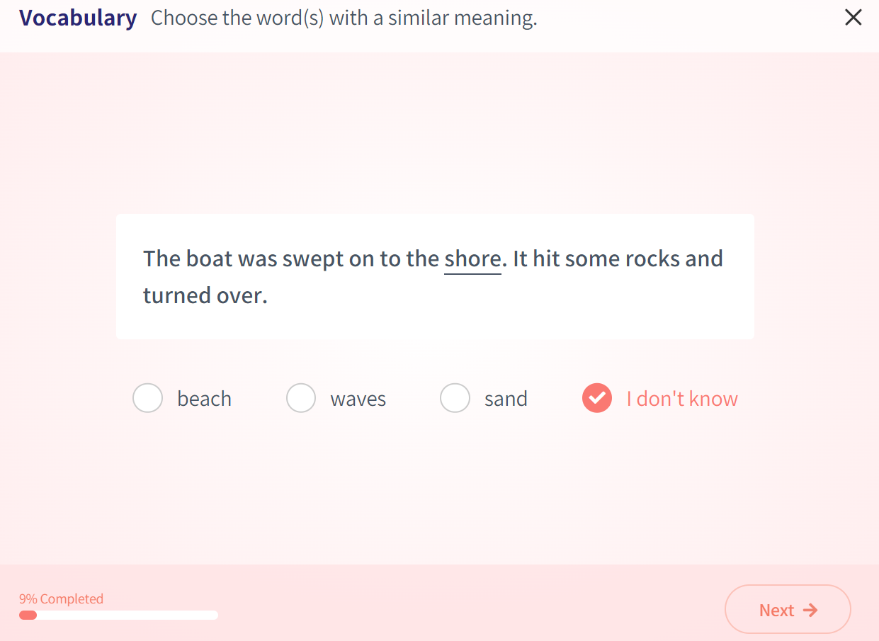
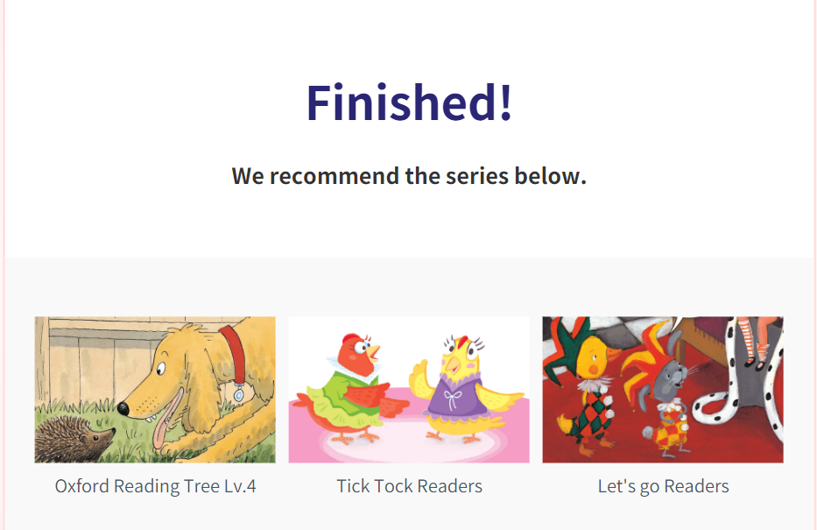
Where to start?
If you are not sure which level you are at, do the placement test by clicking Where to start.
Start with your placement test.
When you are finished, you will see the recommended collection(s).
Which one did you get?
However, you are the one who chooses what to read. ☺

Slide 15
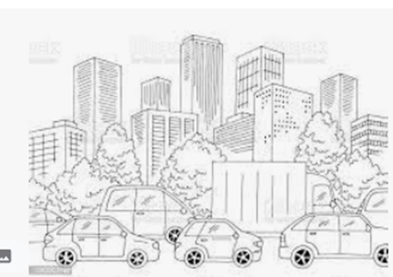
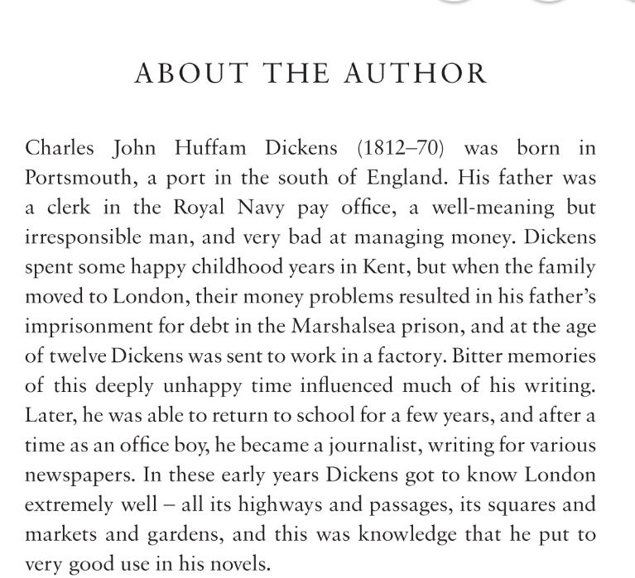
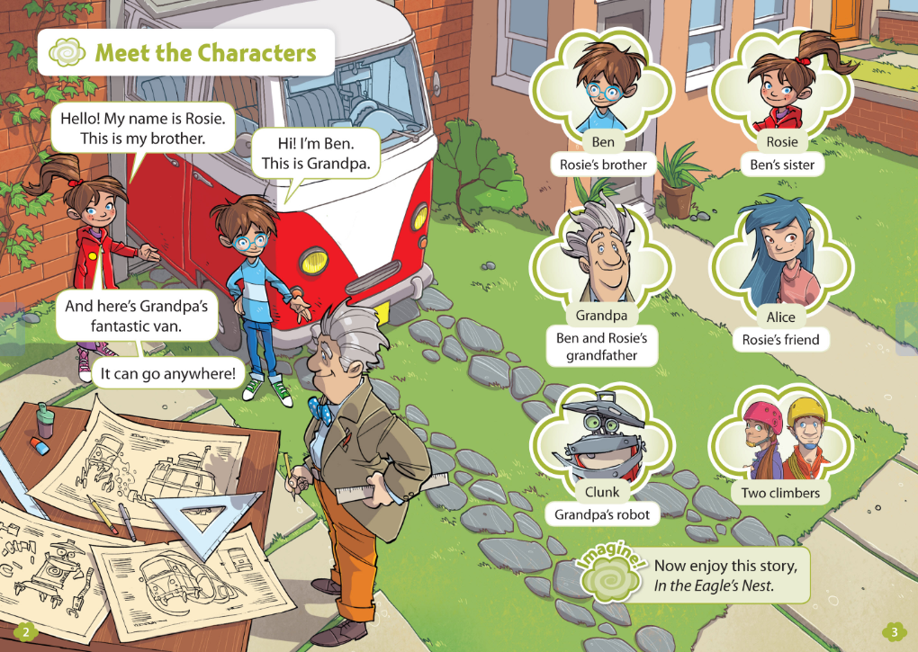
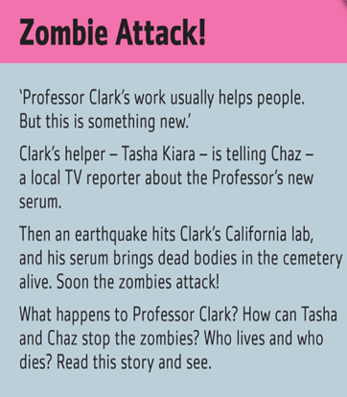
Choose and describe:
Choose an e-book that you would like to read and don’t tell it to anyone.
In pairs or small grups, talk about your book so that your teammates can find it in the ORC and guess the title.
In your group you can use these ideas to talk about your book:
Describe the front-page photo of your reader as detailed as possible so that your classmate can draw it.
Read the short summary and retell the plot of the story to the others.
Give a few important information about the author.
4) Describe the characters.

Slide 16

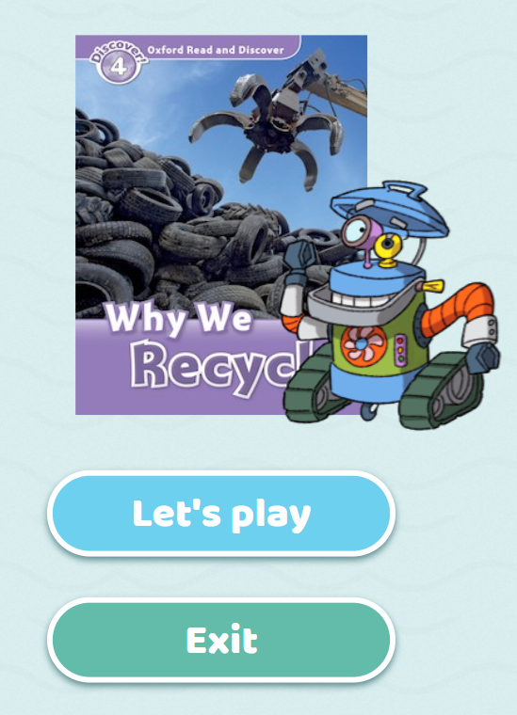
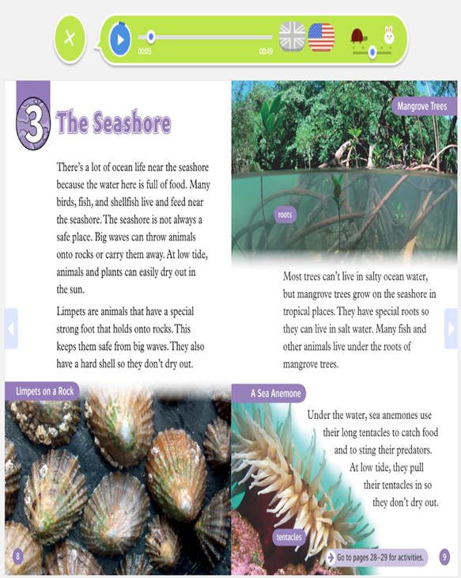



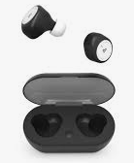

reading:
Do the warm up activity ( optional)
Read as many pages as time allows
You can read and listen
Use earphones if necessary
Determine pace and dialect

Slide 17
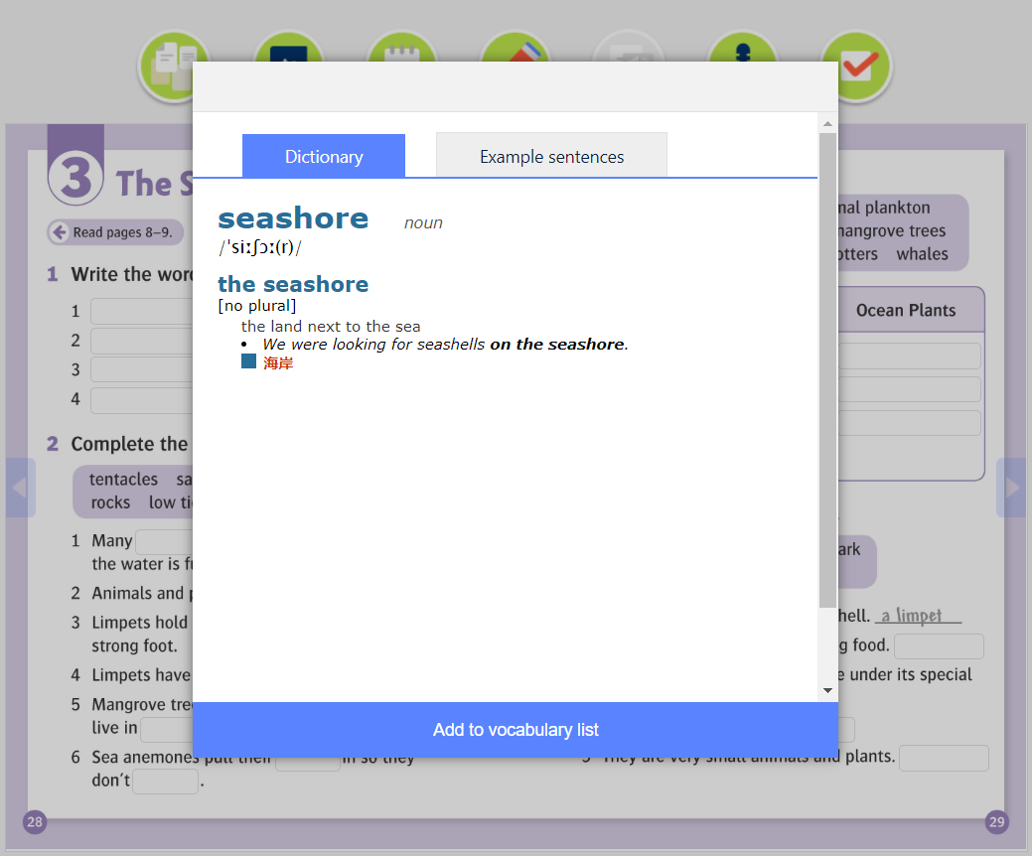
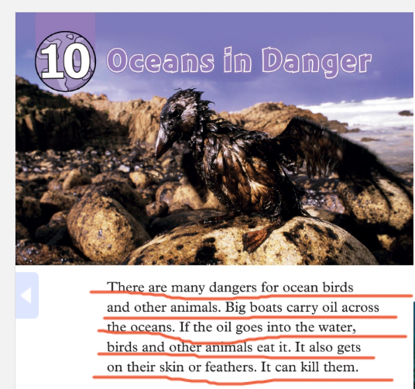

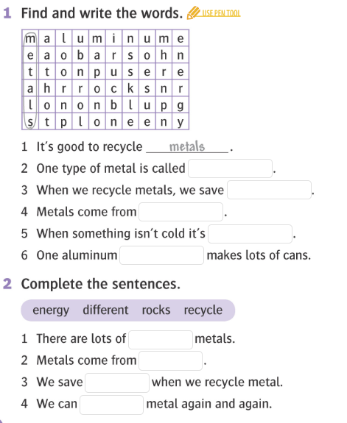


While-reading tasks:
Find the meaning of any unknown words (dictionary) and add them to your vocabulary.
Underline the most interesting sentences/paragraphs/parts.
After each chapter, do the exercises (reading comprehension, vocabulary and grammar).

Slide 18

Reading club discussion:
In pairs, small groups or as an entire class discuss what you have just read.
You can use these example questions:
What is your reader about?
Do you like it?
What have you underlined and why?
Any unknown words? (...)
Notes:
Picture credit: https://www.schooloutfitters.com/blog/3-questions-to-ask-when-planning-your-21st-century-learning-environment
18

Slide 19

Notes:
Picture credit: https://www.vecteezy.com/vector-art/1220888-the-world-belongs-to-those-who-read-quote
19

