Slide 1




Slide 2


WORKSHOP: Oxford Read and Discover

Slide 3
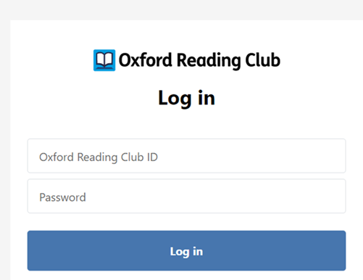
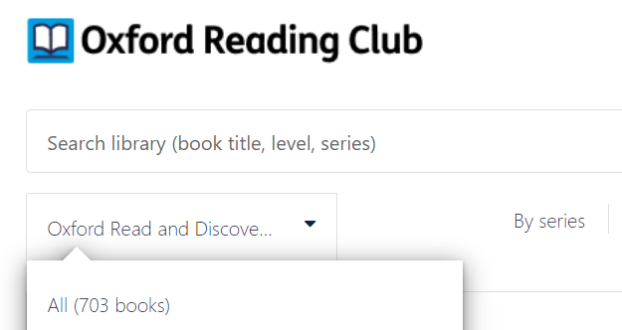
Let’s get started!
Step 1:
Click here and log in to Oxford Reading Club by using your ID and password :
Step 2:
Find the collection: Oxford Read and Discover!

Slide 4




What can we discover by reading?
Quickly skim and scan the books within Oxford Read and Discover collection and write the titles in the correct column:
Compare your answers with your classmates.
Science and technology | The natural world | The world of arts and social sciences

Slide 5




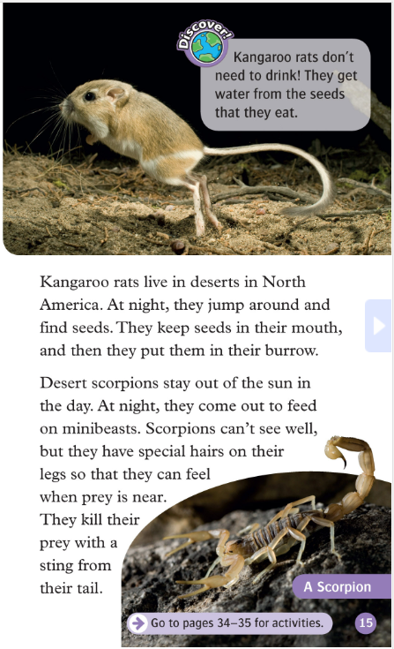
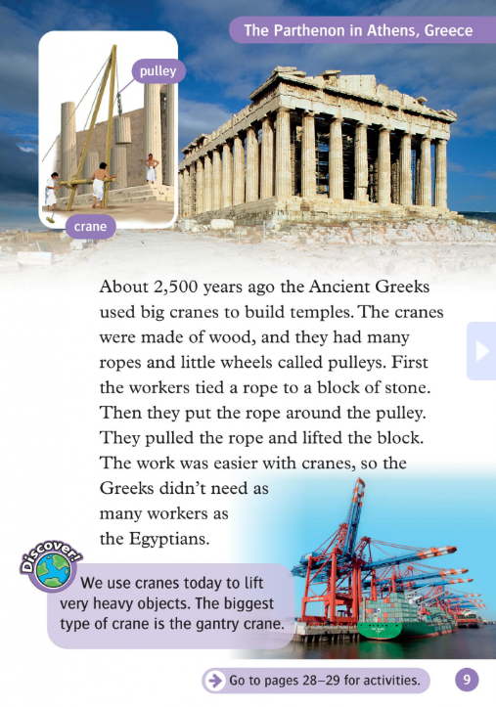
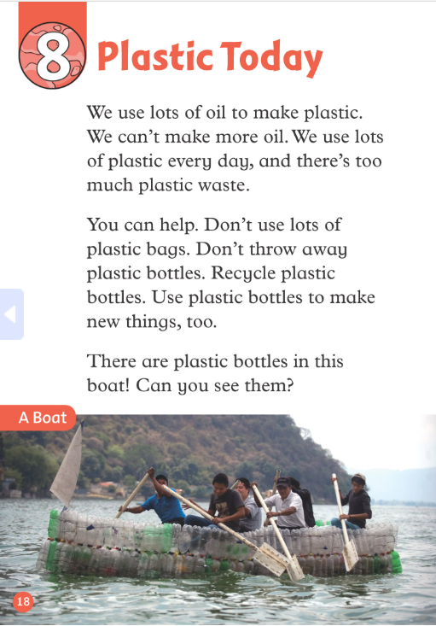
Listen and guess!
What are these books about? Our world, science, technology or something else?
Listen carefully and guess the topic? Any key words to help you decide? Write them down.

Slide 6





Discuss these questions in pairs/groups:
Which books you like best? Those about science and technology, our world (animals and plants) or about arts and music?
What can you discover by reading them? What do you find most fascinating and why? What is not that interesting to you?
Notes:
Photo credit: https://kyoiku.sho.jp/89227/
6

Slide 7
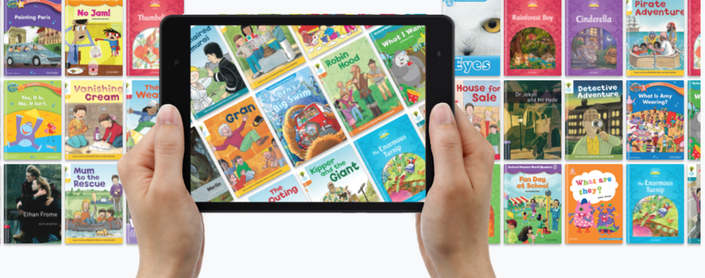
Read your way to better English! ☺
Choose a reader from Oxford Read and Discover collection that you will read.
Which one did you choose? Why? Compare with others?
Notes:
7

Slide 8

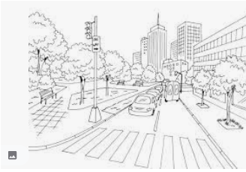
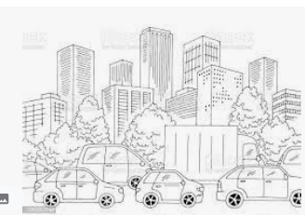
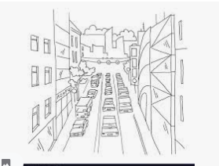
Listen and draw so you can guess the reader!
Describe the front-page photo of your reader as detailed as possible so that your classmate can draw it.
Now look at your classmates’ photos.
Whose picture is most like the original?
Can they find the reader in Oxford Reading Club?
What’s the title?
Notes:
Photos credits: https://www.istockphoto.com/illustrations/drawing-of-a-traffic-jam
https://www.alamy.com/traffic-jam-street-road-graphic-black-white-city-landscape-sketch-illustration-vector-image368252908.html
https://www.vectorstock.com/royalty-free-vector/city-street-traffic-jam-linear-perspective-sketch-vector-19256282
8

Slide 9




Pre-reading activities:
Record two questions that you believe to find the answers to in the book and save them to the front page.
Write down 5 key words that will appear in the
book.
In pairs or in small groups, play the questions, read the words and comment the possible answers.
Notes:
9

Slide 10

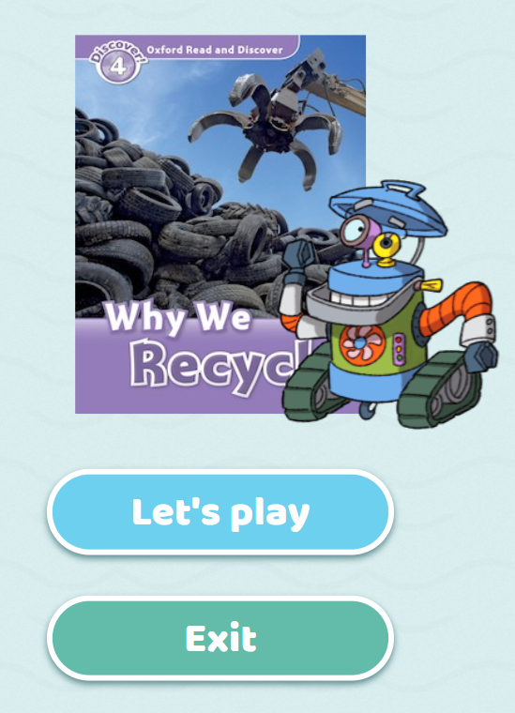

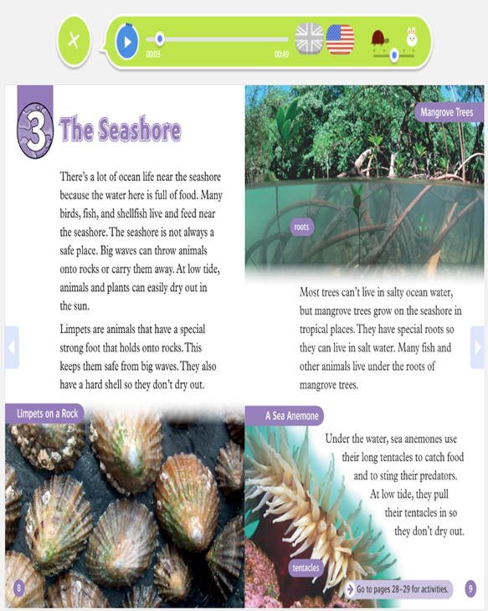




reading:
Do the warm up activity ( optional)
Read two chapters:
You can read and listen
Use earphones if necessary
Determine pace and dialect
Notes:
10

Slide 11
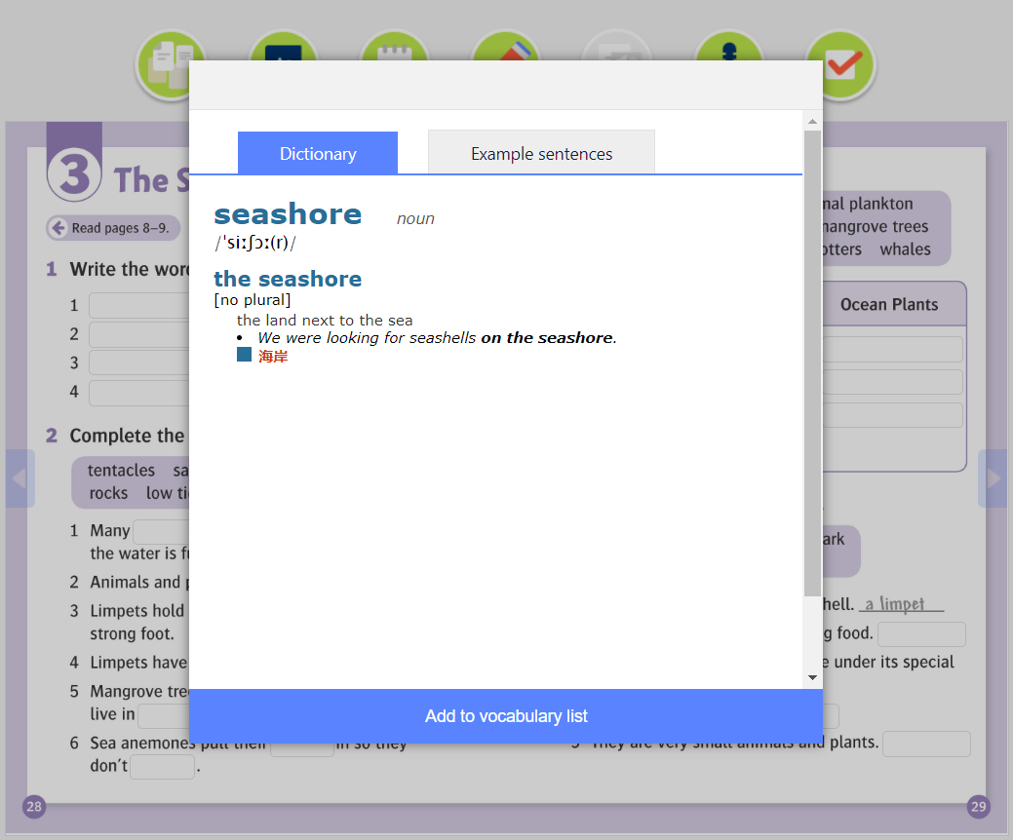

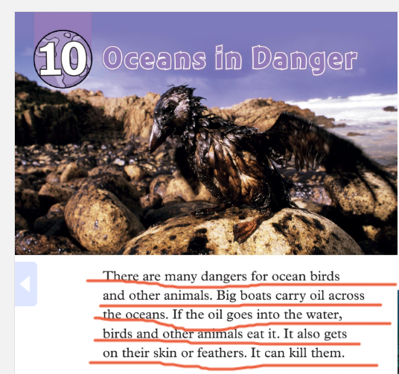
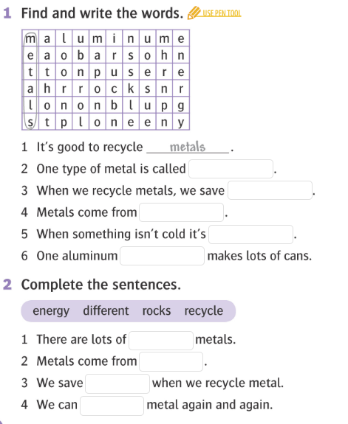


While-reading activities:
Find the meaning of any unknown words (dictionary) and add them to your vocabulary.
Underline the most interesting sentences
After each chapter, do the exercises (reading comprehension, vocabulary and grammar)
Notes:
11

Slide 12


After-reading activities:
In pairs, small groups or as an entire class discuss what you have just read.
You can use these example questions:
What is your reader about?
Do you like it?
Have you already found the answers to your questions?
What have you underlined and why?
Any unknown words? (...)
Notes:
Photo credit: https://www.schooloutfitters.com/blog/3-questions-to-ask-when-planning-your-21st-century-learning-environment
12

Slide 13

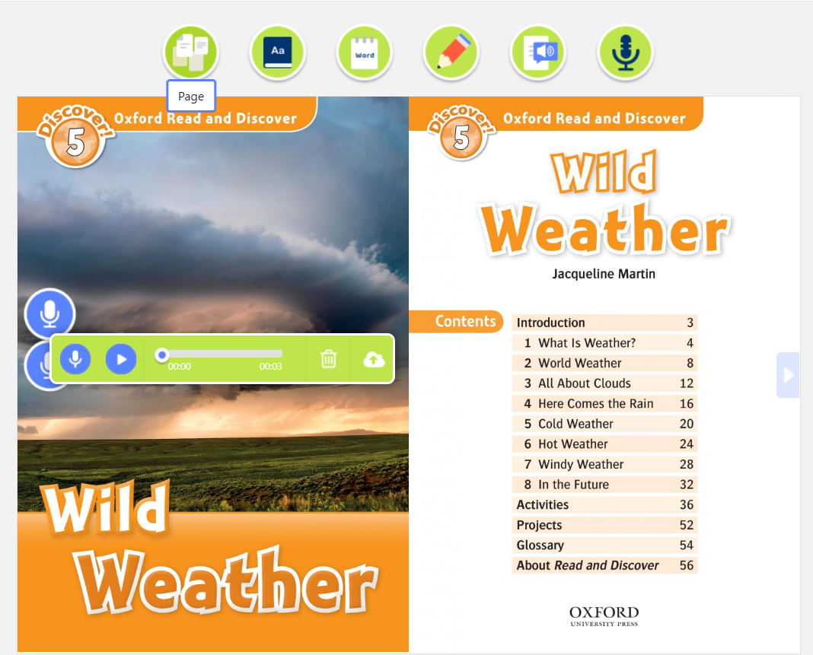
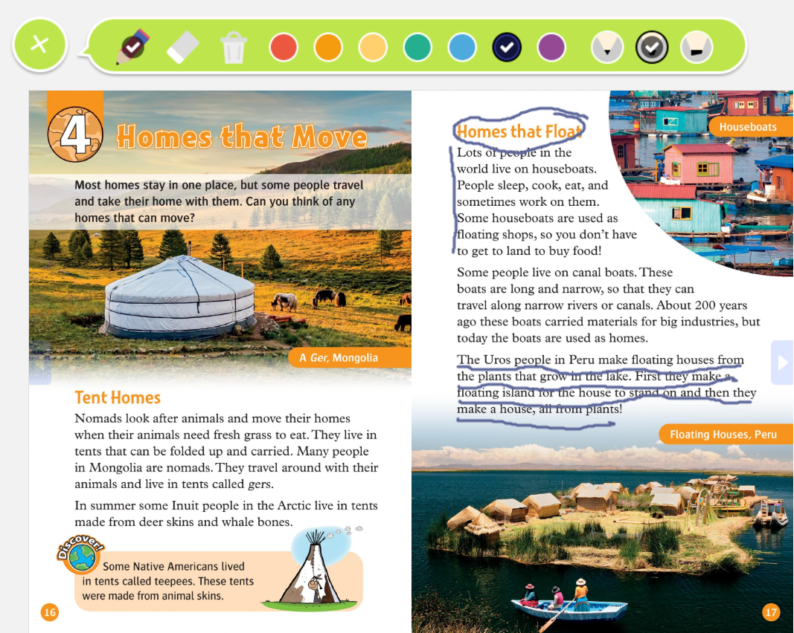
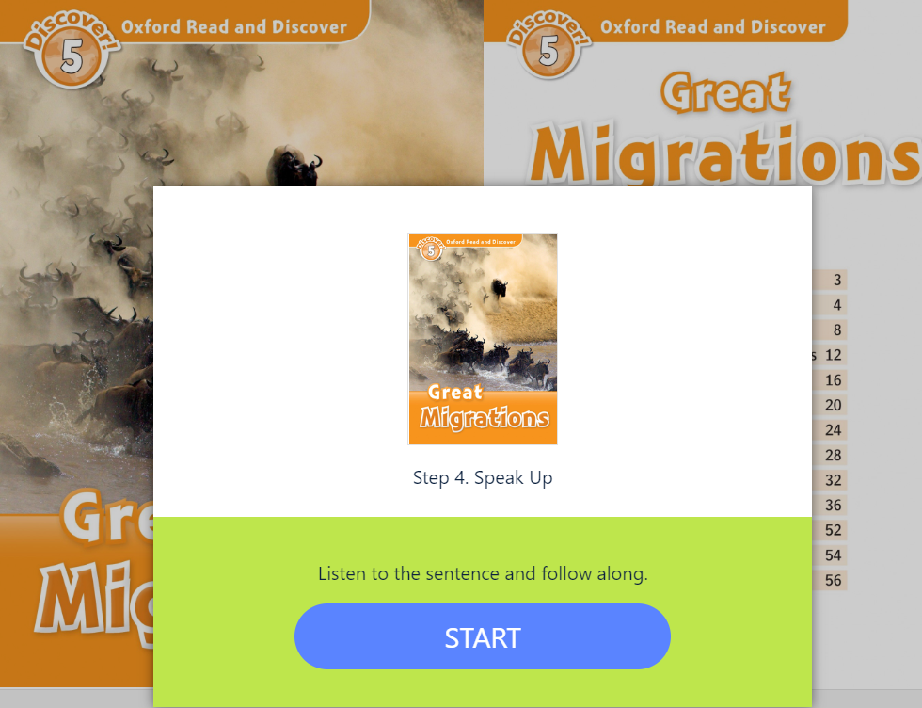
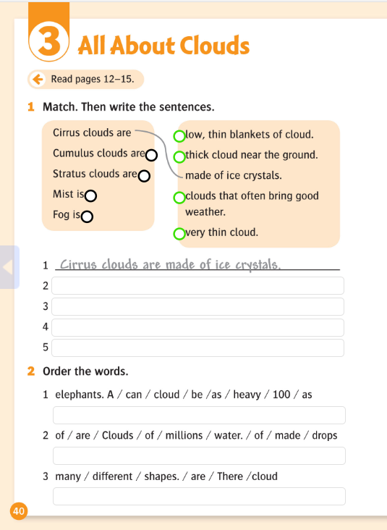
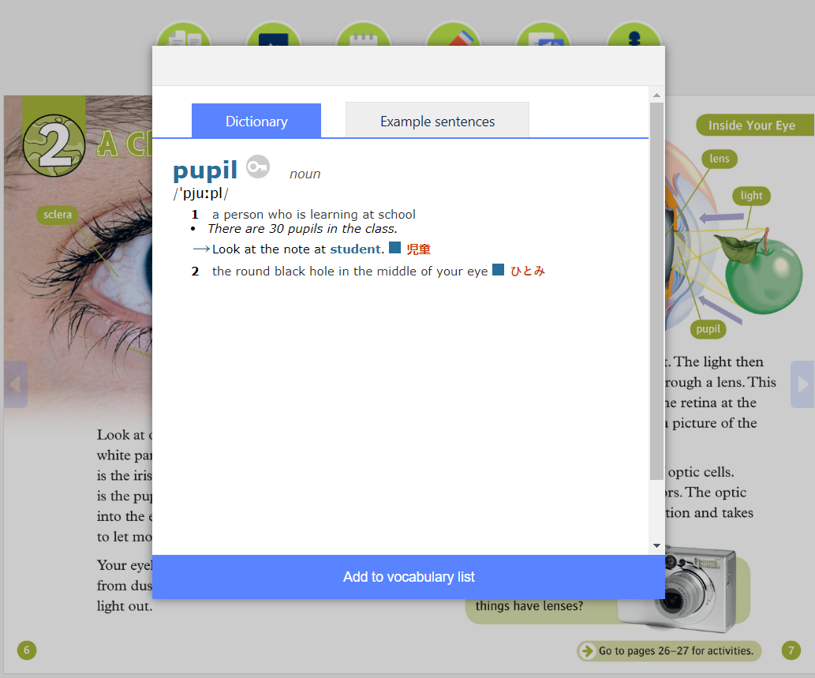
Finish your reader at home. Anywhere, anytime.
Your 5 tasks while reading at home:
Use dictionary to find all unknown words and add them to your vocabulary list
Underline at least 3 paragraphs, descriptions, characters that you find the most interesting/exciting/important(...)
Find, record and save the answers to the questions recorded at the front page of your reader.
If you want ☺, do the exercises within your book and/or finish reading with speak up and wrap up activities.
The most important task for you is to ENJOY your reading. ☺
Notes:
Photo credit: https://www.freepik.com/premium-photo/portrait-happy-middle-eastern-family-using-laptop-together-home-arabic-parents-their-cute-little-daughter-relaxing-with-computer-couch-living-room-watching-movies-enjoying-weekend_22279835.htm
13

Slide 14




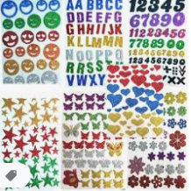


Bring for the next time:
Posterboard, cardboard or cardstock
Color markers
Scissors
Glue
Photos related to the theme (optional)
Decorations(...)
Notes:
Photos credits:
https://shop.mica.edu/uhu-glue-stick-jumbo-141-oz.html
https://dmm-unik.hr/kategorija/vrtici-i-skole/papir-i-papirnati-proizvodi/paus-papir
http://www.efos.unios.hr/oglasavanje/wp-content/uploads/sites/234/2013/04/Ogla%C5%A1avanje_analiza-masovnih-medija_strategije.pdf
https://allegro.pl/artykul/pisaki-dla-dziecka-jak-dobrac-wlasciwe-do-wieku-dziecka-56375
https://www.amazon.in/ASHOP-Adhesive-Alphabets-Butterflies-Multicolour/dp/B07N1RBKJK
https://i5.walmartimages.com/asr/827c911b-4f78-43d7-b4ad-60e0f274b0d6.91132beb8778f15eb069b8adb569b773.jpeg
14

Slide 15

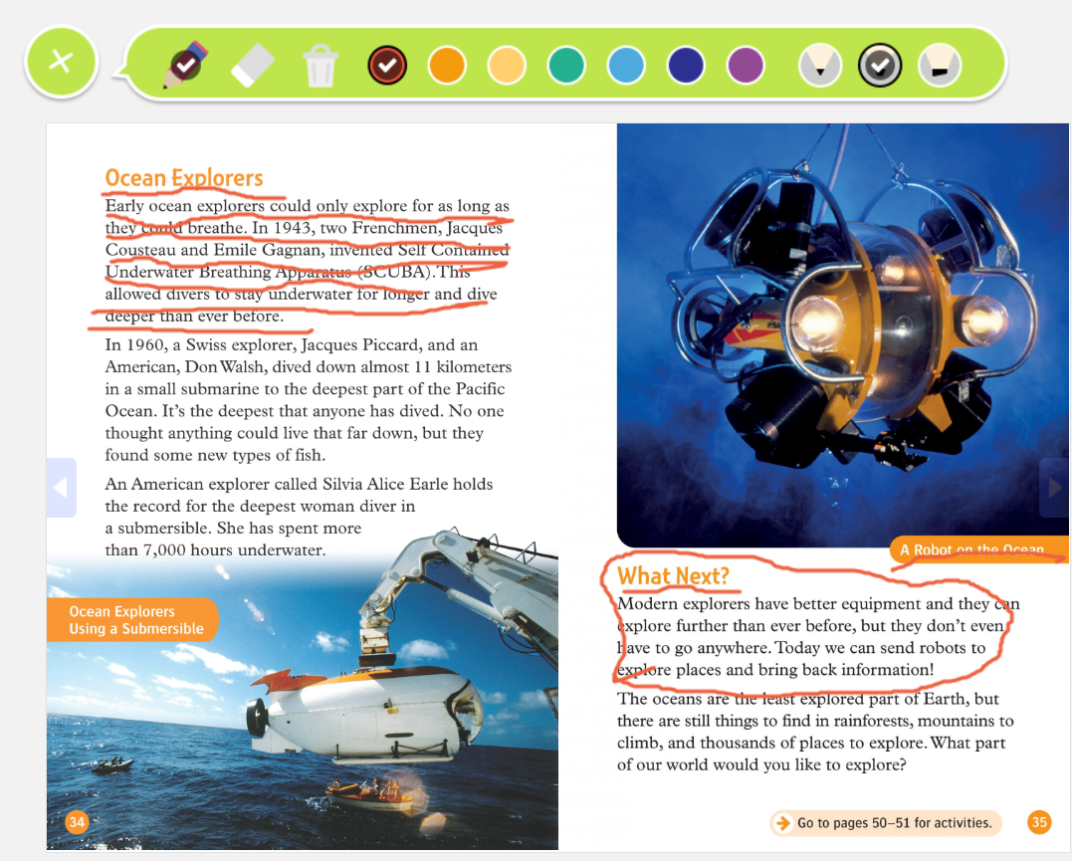
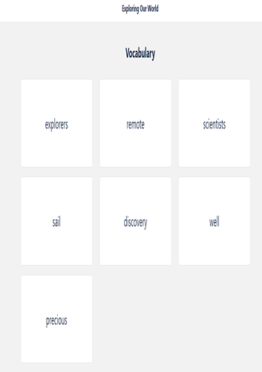

Workshop time!
Introductory discussion
In pairs, small groups or as a class discuss what you read at home:
What’s the title of the reader?
What is it about?
Did you stick to the schedule?
Was it fun?
Did you encounter any difficulties?
Now, read and comment your favourite, underlined paragraphs, show your vocabulary list and play your questions and answers.
Would you recommend your book? Why yes/no? Comment in pairs or groups.
Notes:
Photo credit: https://www.istockphoto.com/photos/circle-child-sitting-in-front-of
15

Slide 16


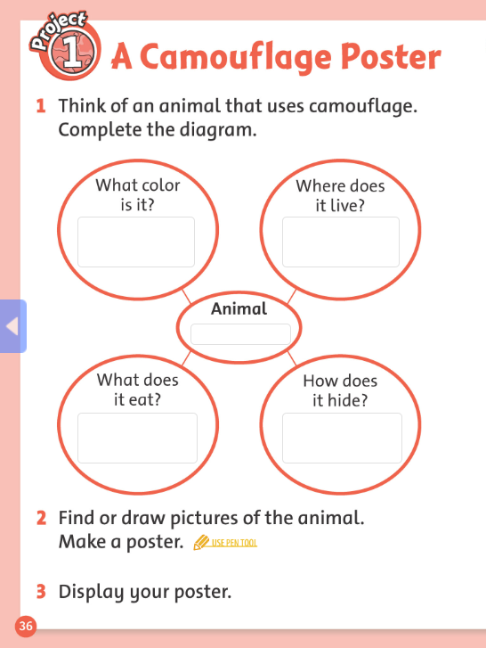

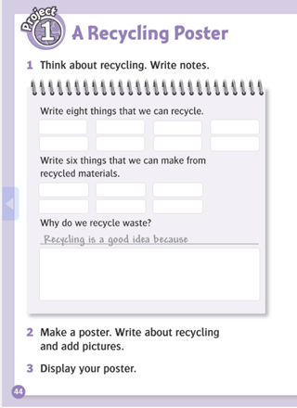

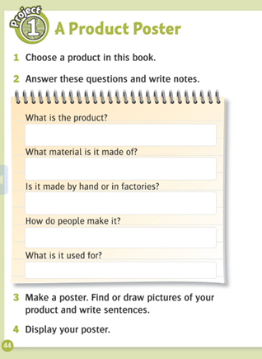
Workshop time- Lets make posters!
Decide on the content and structure of your poster (elaborated ideas from the reader+ your own ideas)
Comment your ideas in pairs/groups
Write down your first, draft version and compare in group (check your language, share ideas etc.)
Add more content if necessary
Finish your poster- draw, add pictures and decorate
Show your posters in pairs, comment on them, correct/add something if necessary
Notes:
16

Slide 17
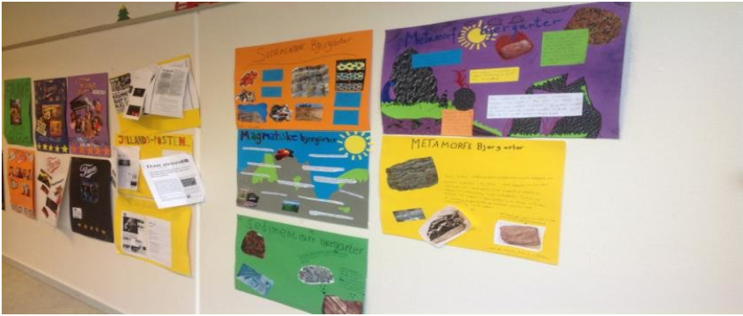
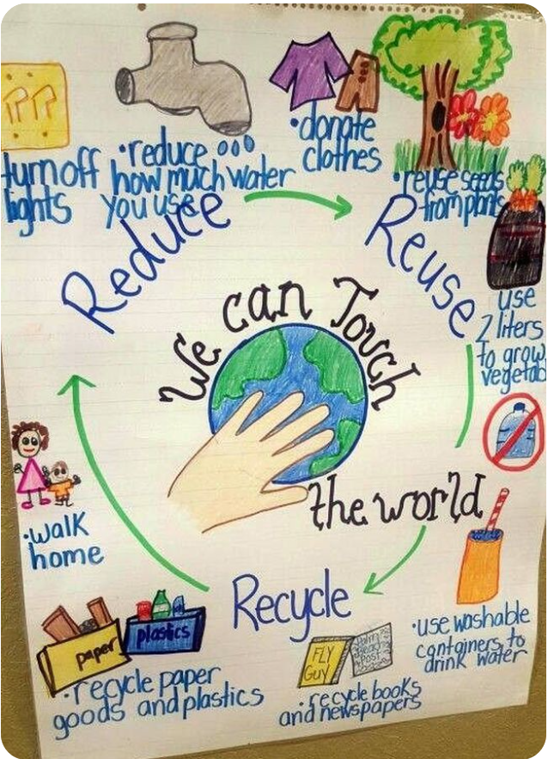
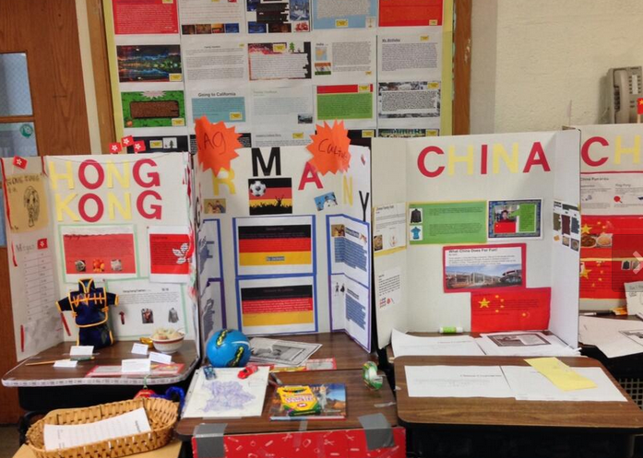
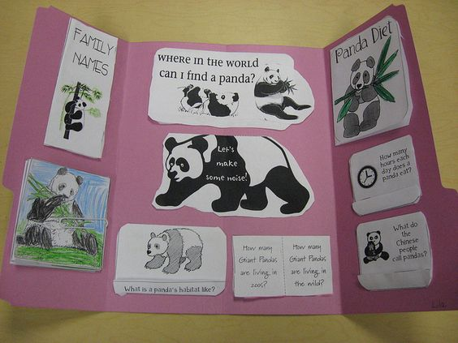
Exhibition Poster
Display the posters around the classroom, walk and comment on them.
Choose the most interesting one. ☺
Notes:
Photos credits:
https://www.researchgate.net/figure/Posters-made-by-students_fig1_301618954
https://www.pinterest.com/pin/667517976003619510/
https://www.google.com/url?sa=i&url=https%3A%2F%2Ftwitter.com%2Fcristoreyny%2Fstatus%2F1443927668056023041&psig=AOvVaw1j1KSoQhTwIAD7v__5i3B5&ust=1664351925614000&source=images&cd=vfe&ved=0CA0QjhxqFwoTCNDvpJzAtPoCFQAAAAAdAAAAABAE
https://www.pinterest.com/pin/249949848038811163/?nic_v3=1a5agbtmO
17

Slide 18
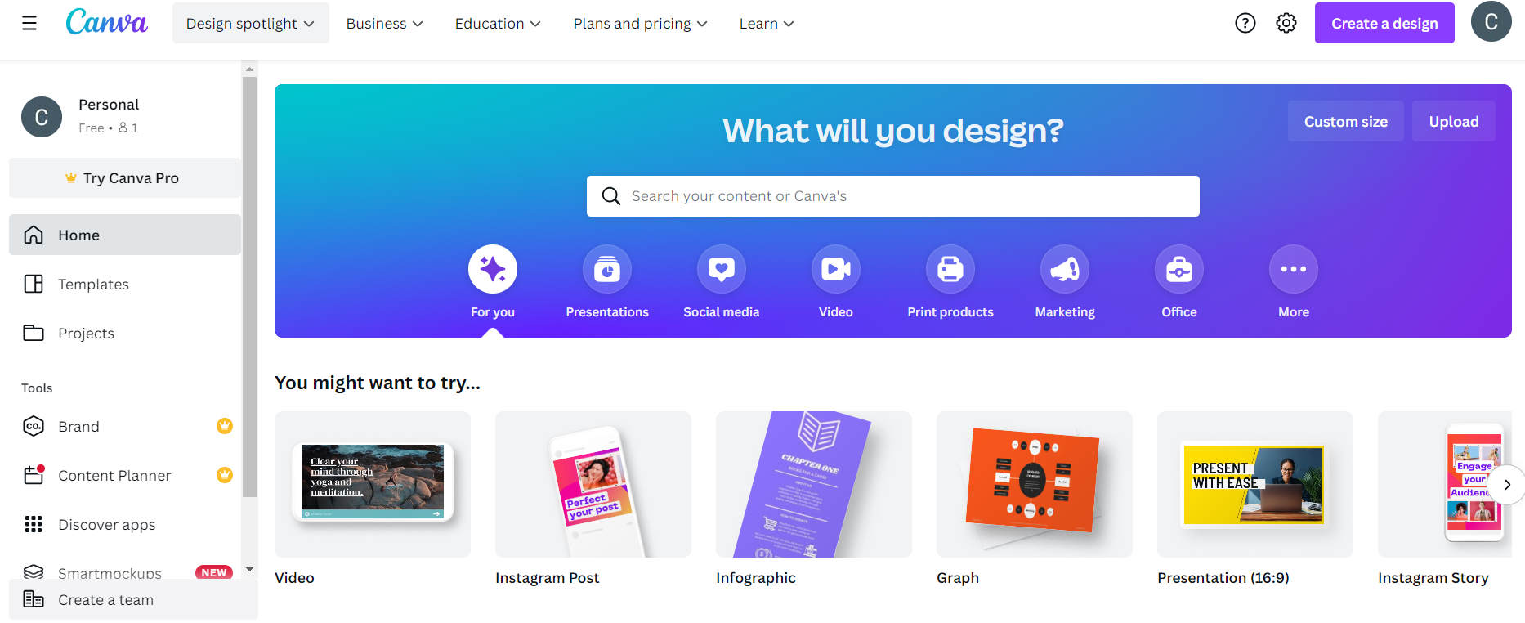
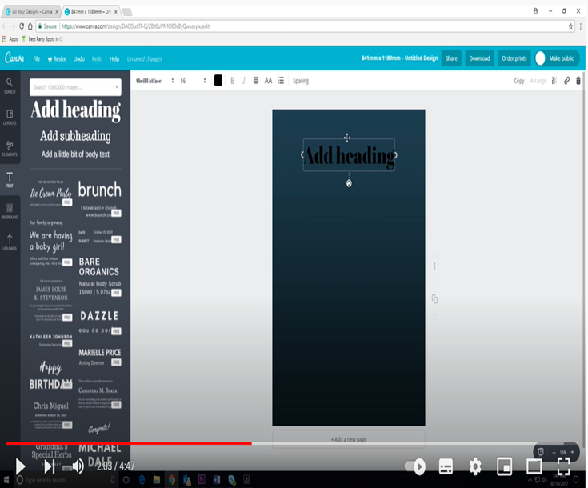
Extra idea! Make your posters on your PC, in Canva.
Register to free-to-use online graphic design tool:
https://www.canva.com/
How to register:
https://www.tutorialspoint.com/how-to- create-a-new-canva-account
Decide on the content of your poster
Explore how to make posters in Canva:
https://www.canva.com/create/posters/
https://www.youtube.com/watch?v=dCv1oMXk-XM
Design the posters
Display, download, share or print your posters!
Notes:
Photo credit: https://www.canva.cn/en/
18

Slide 19


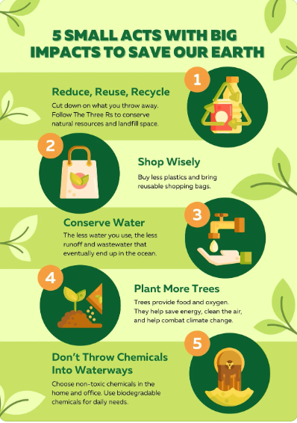
Examples of posters made in Canva:
Notes:
Photo credits: https://www.behance.net/gallery/2811141/Poster-Series-Animal-Awareness
https://www.hsph.harvard.edu/nutritionsource/kids-healthy-eating-plate/
https://www.canva.com/p/templates/EAFAXpV4rys-green-modern-illustrative-save-earth-poster/
19

Slide 20

Comment each other posters, use positive language ☺
Notes:
Photo credit: https://www.teacherspayteachers.com/Browse/Search:positive%20peer%20feedback/
20

Slide 21

Notes:
Photo credit: https://www.vecteezy.com/vector-art/1220888-the-world-belongs-to-those-who-read-quote
21

