Slide 1
Day of remembrance for the victims of Vukovar and Škabrnja

Slide 2
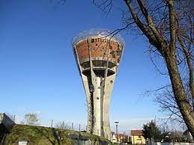
Vukovar water tower

Slide 3
Vukovar
The battle of Vukovar was the biggest and bloodiest battle in Homeland war.
It was the 87-day seige of the Croatian town Vukovar by the Jugoslav People’s army.
It lasted from 1991 to 1995.
About 1, 000 civilians were also killed, and about 7,000 Croatians
soliders and civilians ended up in preson camsp in Serbia.

Slide 4
Škabrnja
The massacare in Škabrnja was awar crime committed by Serbs forces in the time of Serbia-Montenegro’s aggresion aginst Croatia.
84 people deid in the massacare
The massacare has hapend 18. november 1991.
Škabrnja was attacked the same day Serbians chetniks and JNA(Yugoslav People’s army) entered Vukovar
Serbs come to Croatia with tanks 1991. and in Serbia thay returned back with tractors 1995.
Operacion OLUJA was the operacion with wich Croatia defenders relesed Croatia from Serbia and JNA.

Slide 5
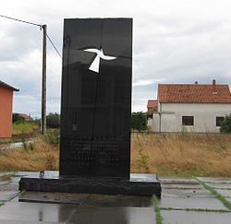
The Memorial Attributes of Mass Tomb

Slide 6
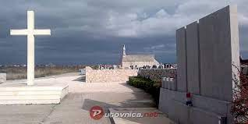
Cemetery in Škabrnja

Slide 7
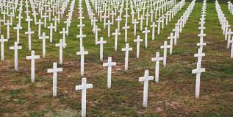
Ovčara(cemetery) in Vukovar

Slide 8
https://www.youtube.com/watch?v=z_Bb_4PUe8g
https://www.youtube.com/watch?v=__Q5DVRao7o

Slide 9
Sources:
Croatian encyclopedia
Youtube

Slide 10
Name’s: Petar Patafta and Ivan Zdolec

